Slide 1
An A-Z of handy hints for using ICT in the history classroom
OR
Twenty-Six Top Tech Tips to Tweak Your Teaching
Corinne Goullée & Matt Stanford
Cottenham Village College

Slide 2
A
s
n
nimatio

Slide 3
Most
animation
is
crap –
don’t use it.

Slide 4
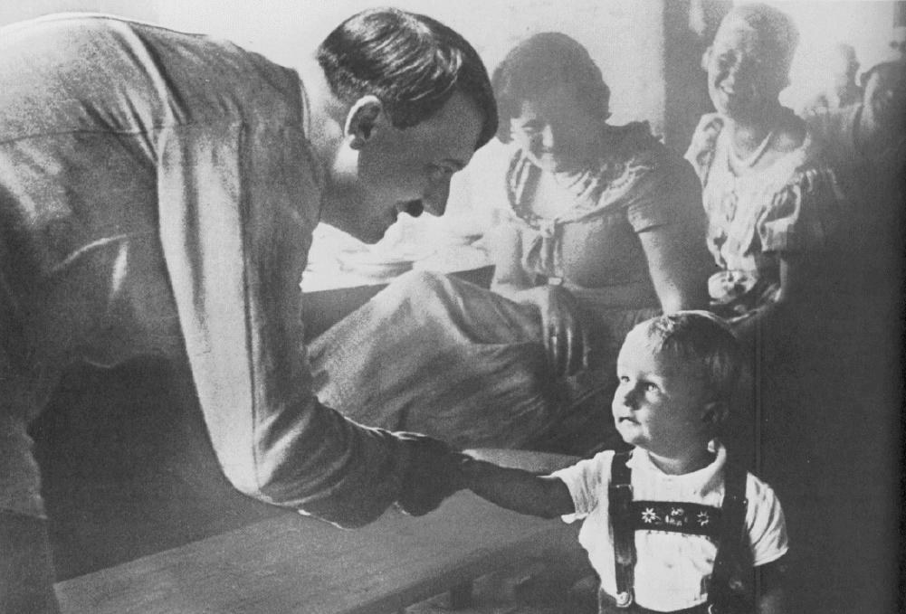
Year 10 on control in Nazi Germany
How would you describe these people?

Slide 5
What is happening in this photograph?

Slide 6
What does this photograph suggest about Hitler?

Slide 7

Year 7 on the causes of the Peasants Revolt
REVOLT!
furious
really angry
angry
grumblng
Notes:
Concept

Slide 8
B
E S
B
O
X

Slide 9
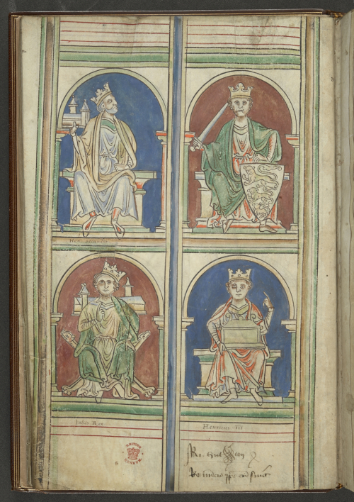

Slide 13


Slide 14
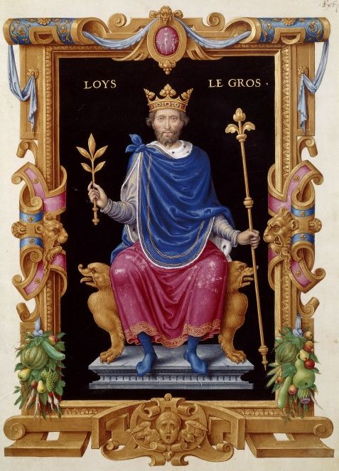
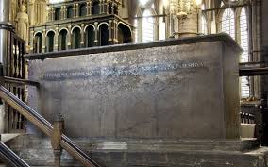

Slide 16
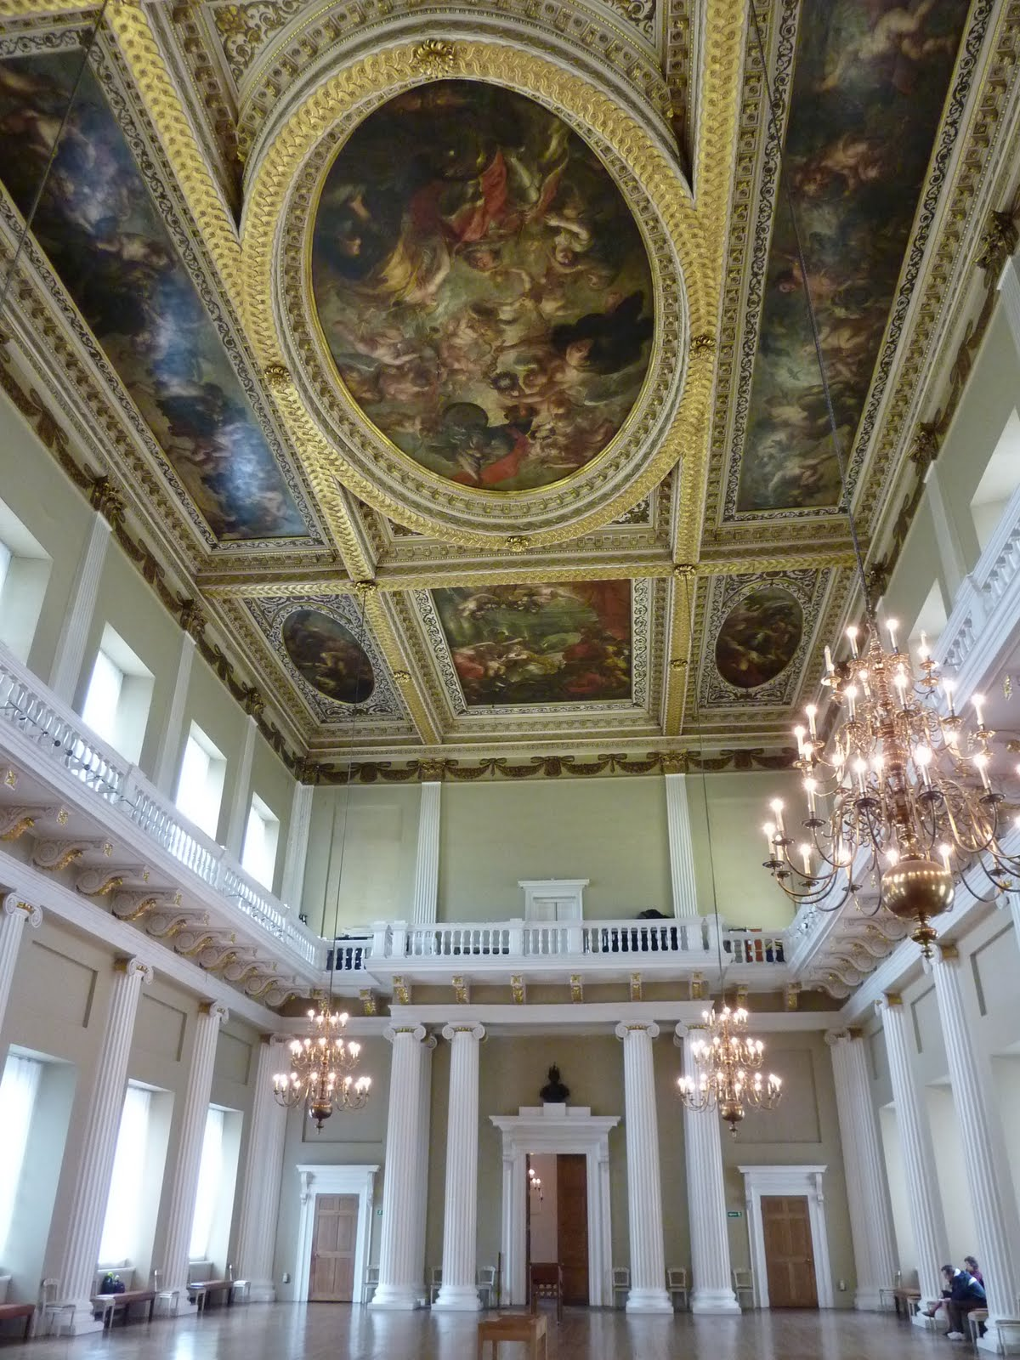
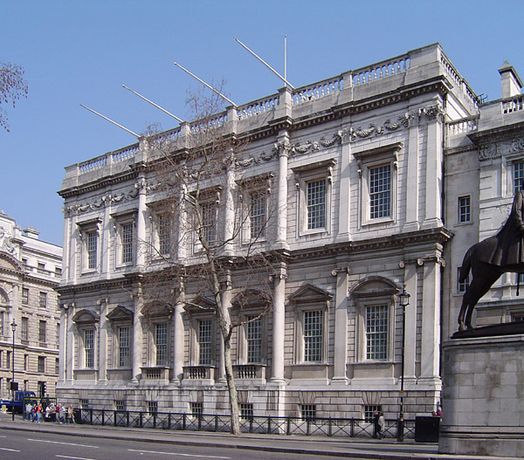
Year 8 on the causes of the English Civil War

Slide 17
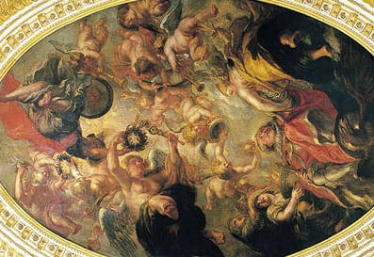
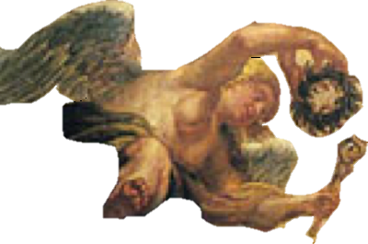

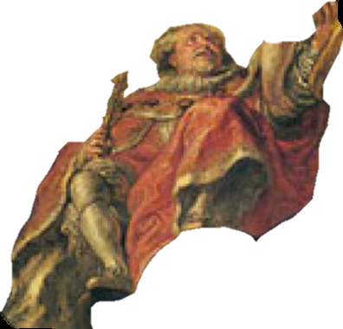
Year 8 on the causes of the English Civil War

Slide 18
Year 8 on the causes of the English Civil War

Slide 19
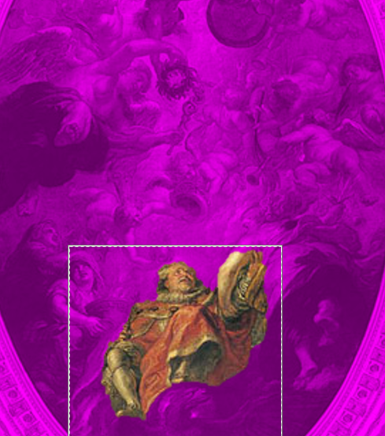
Year 8 on the causes of the English Civil War

Slide 20
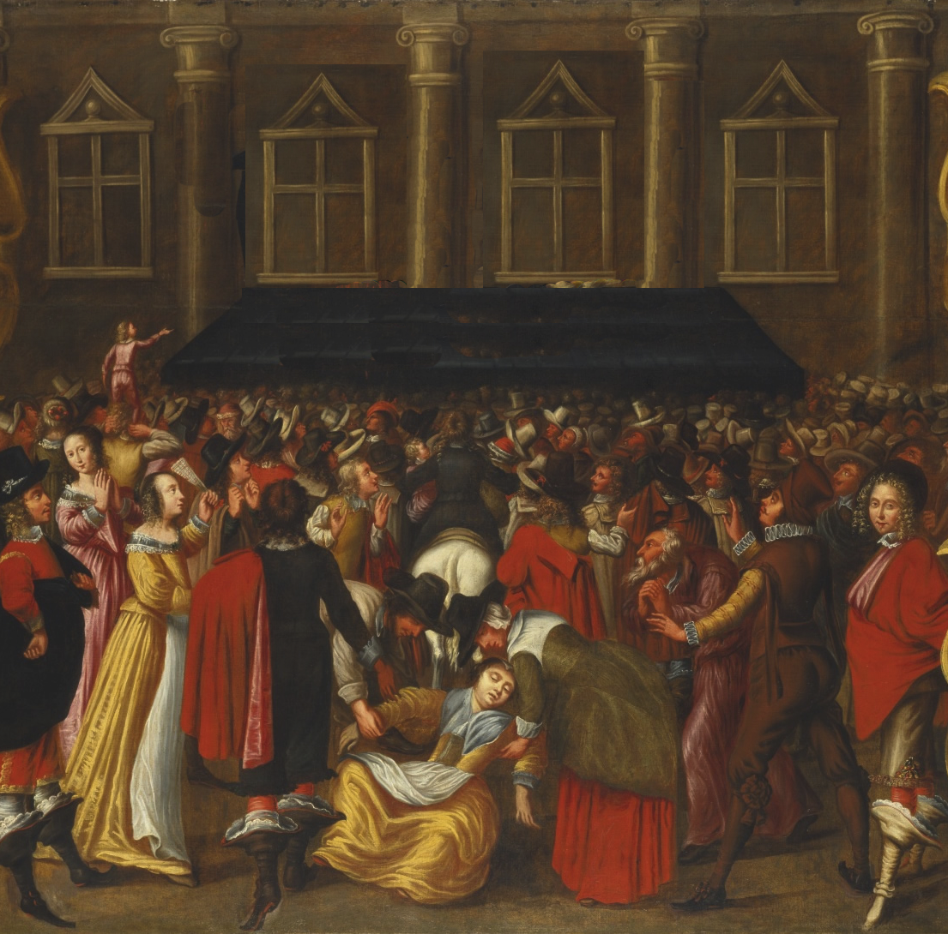
Year 8 on the causes of the English Civil War
?

Slide 21

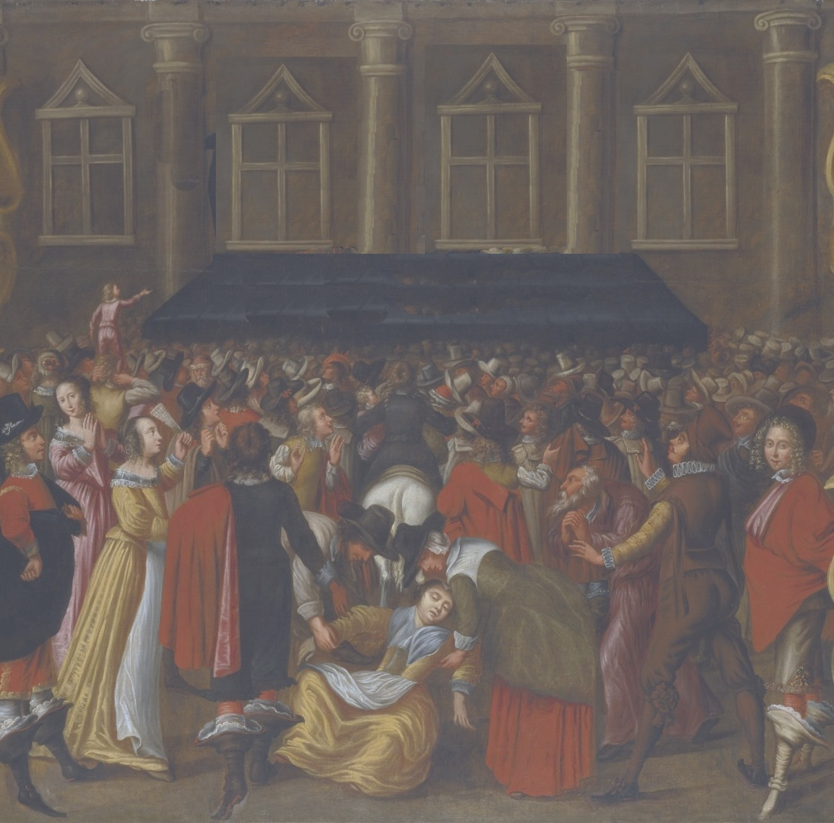
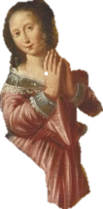
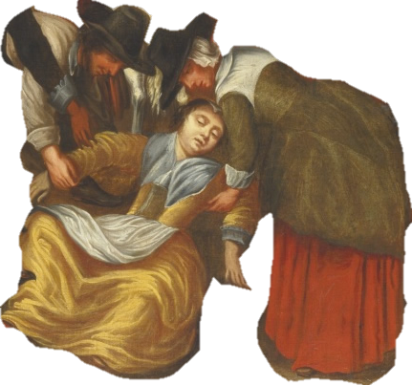
Year 8 on the causes of the English Civil War
?

Slide 22
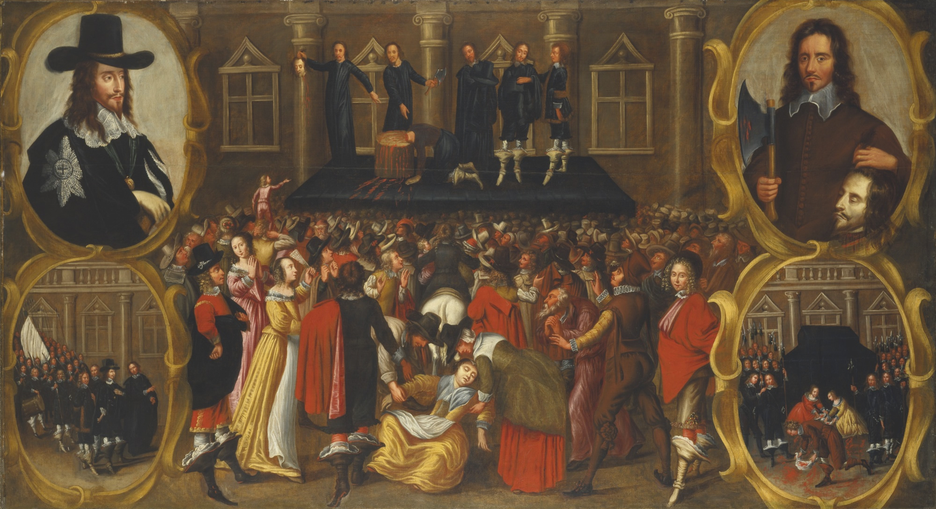
Year 8 on the causes of the English Civil War
?

Slide 23
Year 8 on the causes of the English Civil War

Slide 24
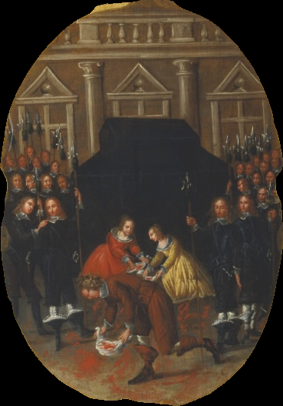
Year 8 on the causes of the English Civil War

Slide 25

(when drawing isn’t your strong suit)

Slide 26
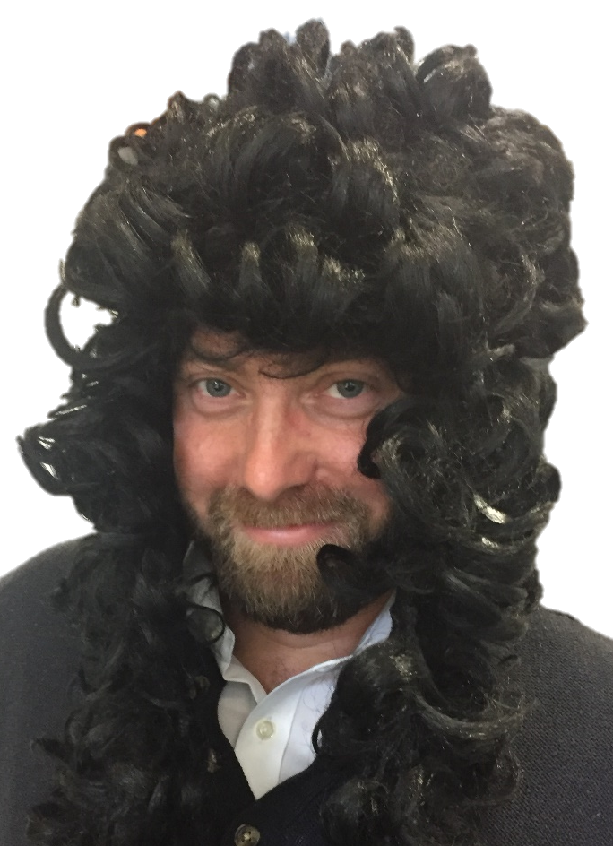


Slide 27
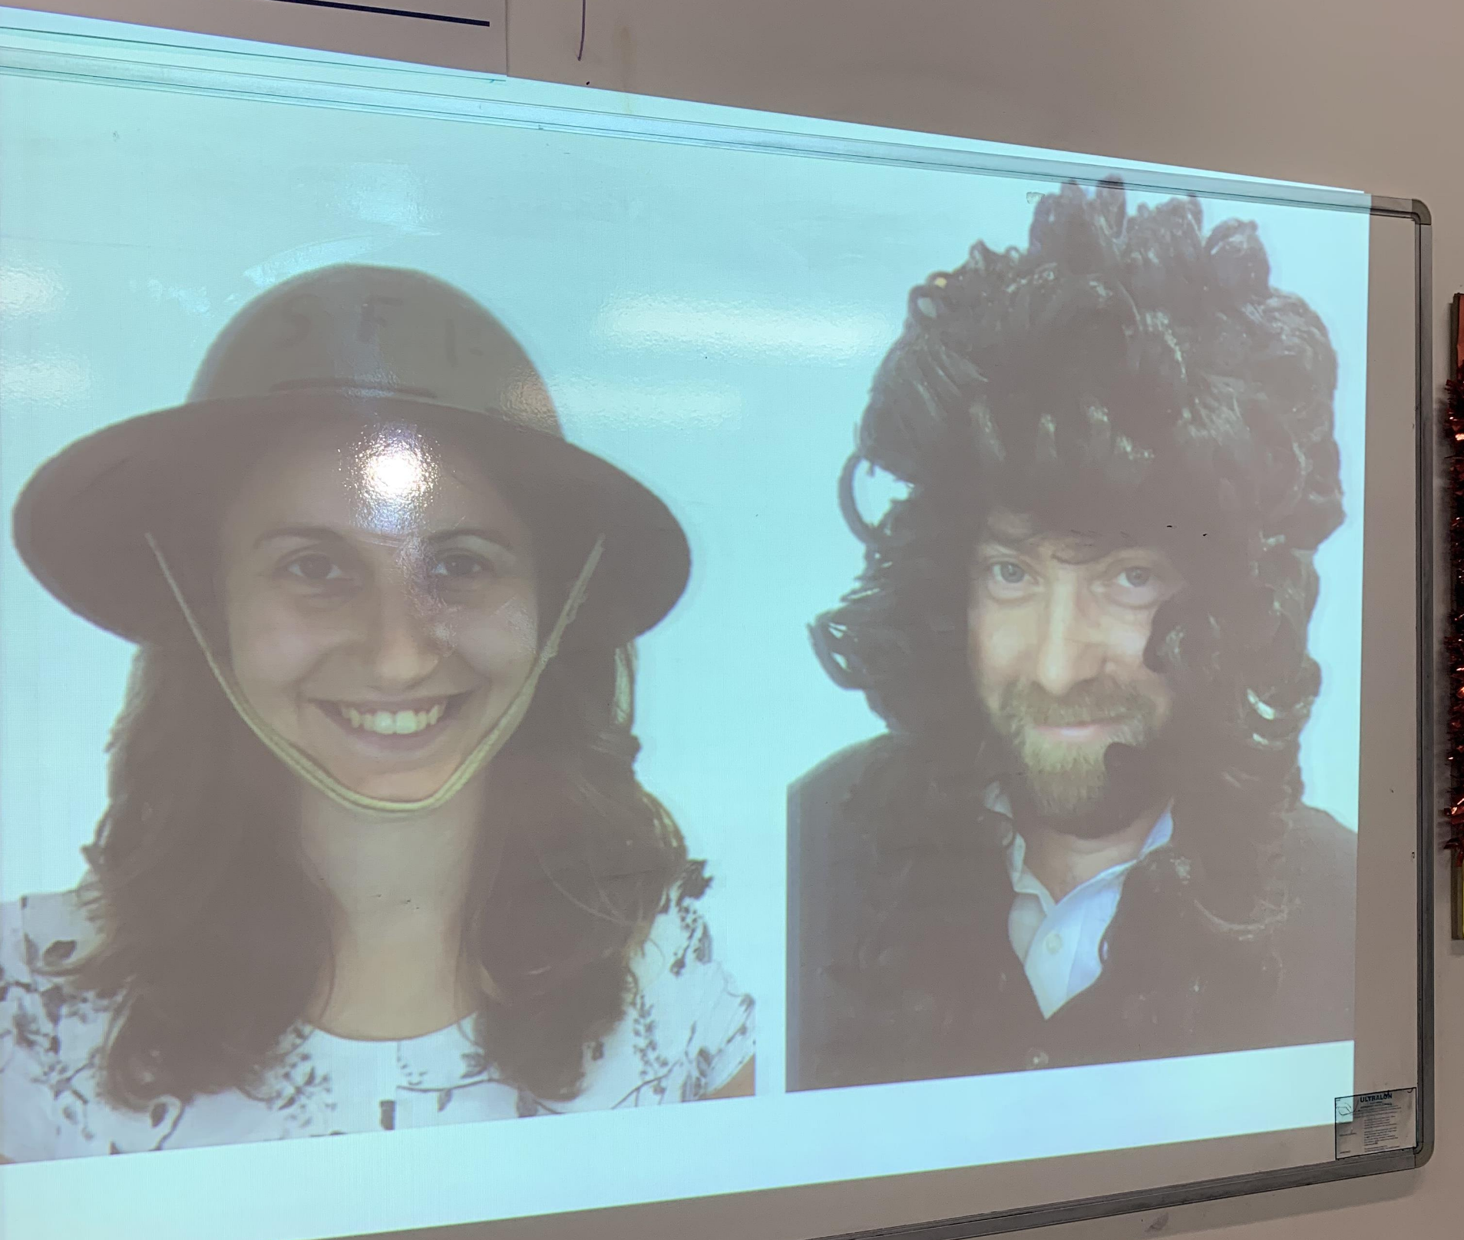

Slide 28
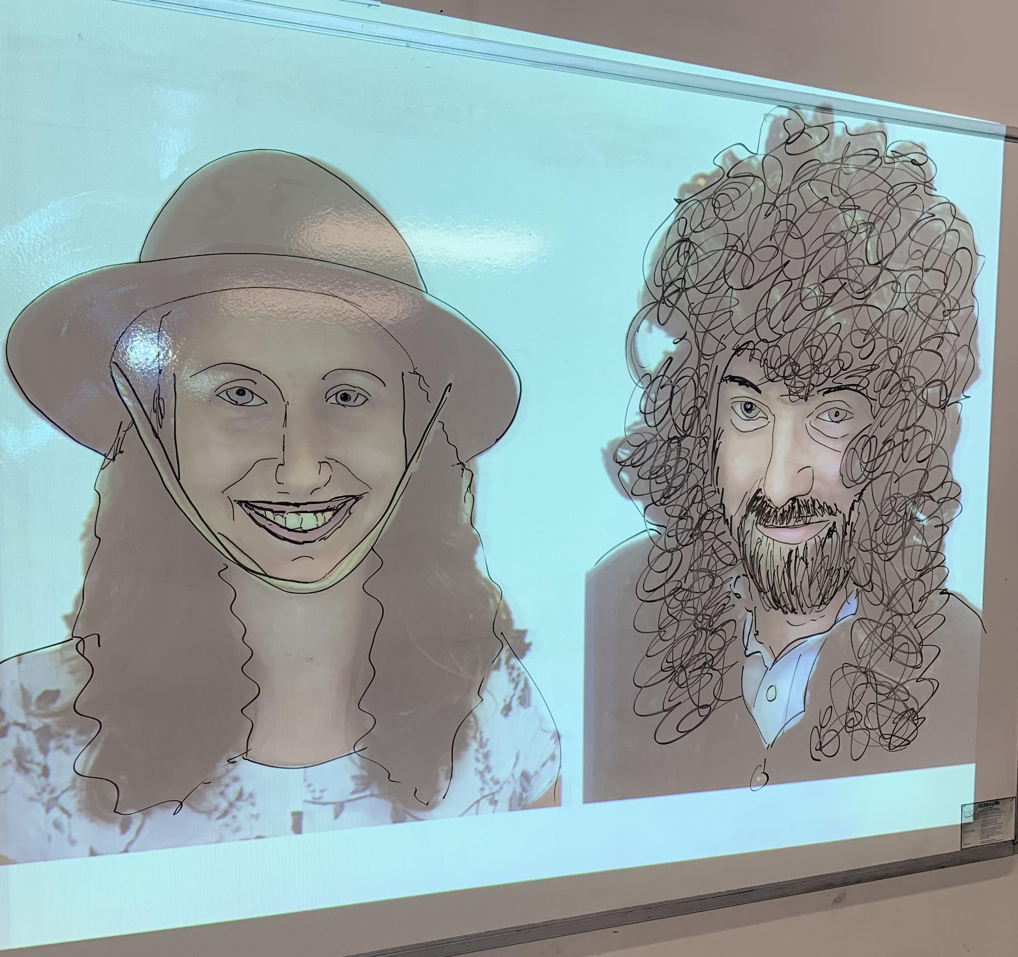

Slide 29
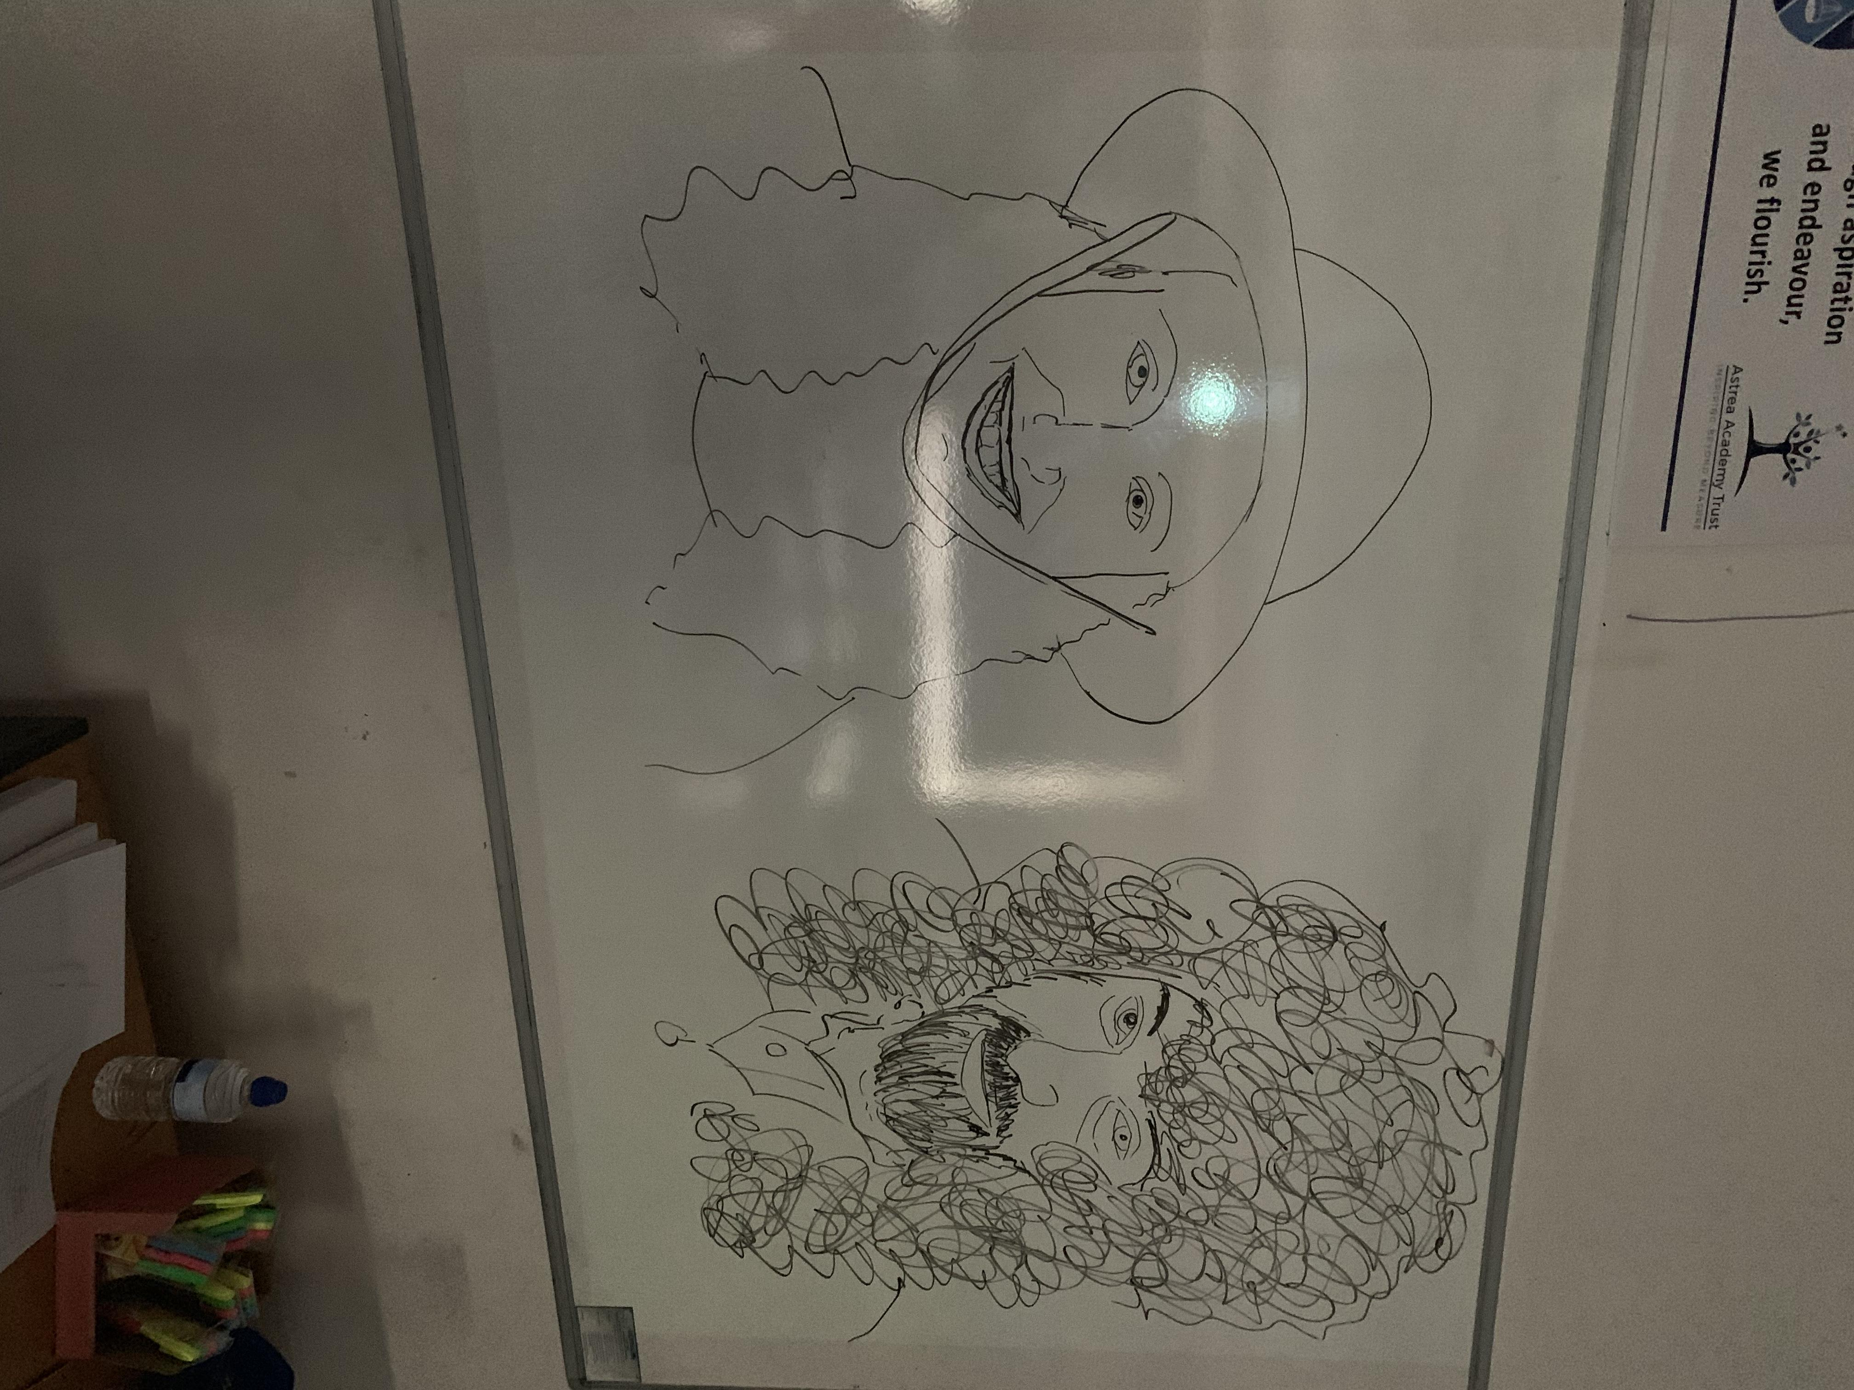

Slide 30
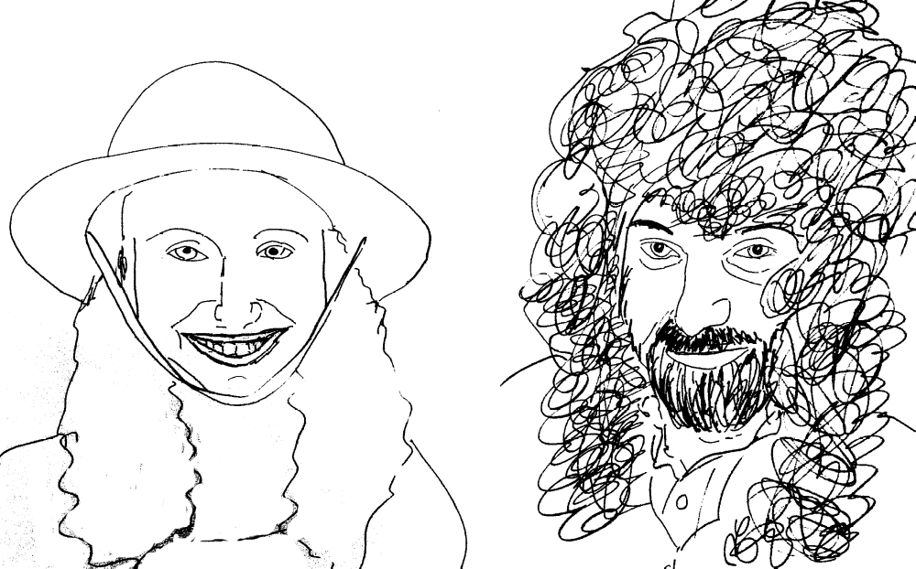

Slide 31
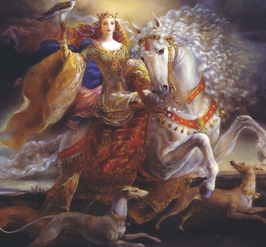
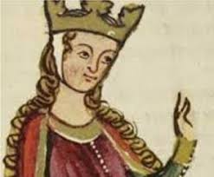
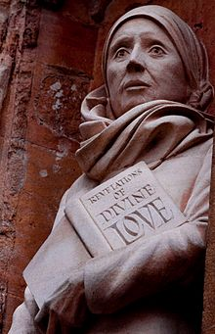
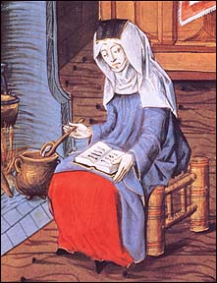
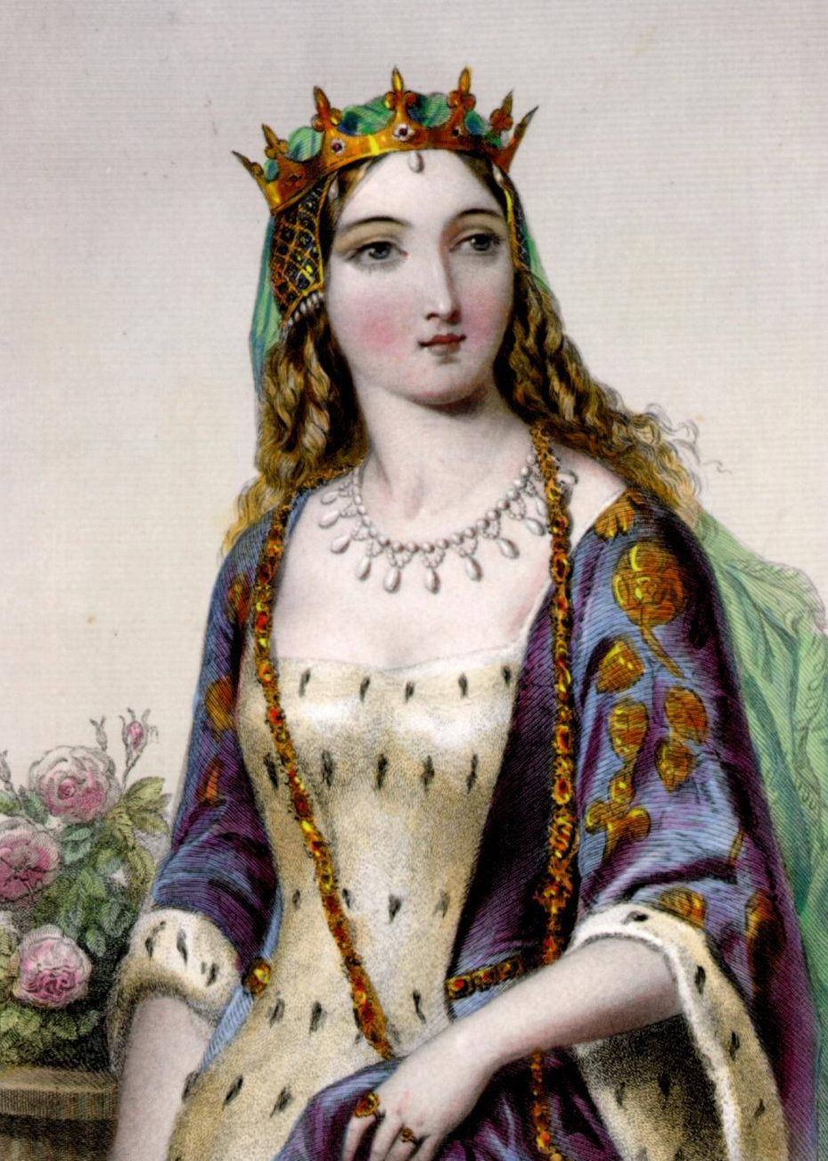
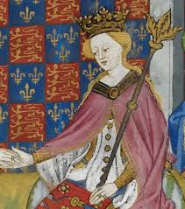
Eleanor of Aquitaine
Julian of Norwich
Margery Kempe
Margaret of Anjou

Slide 32
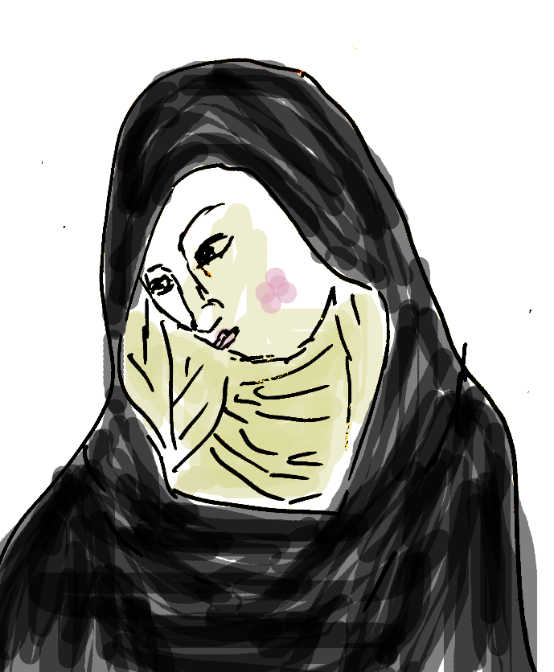
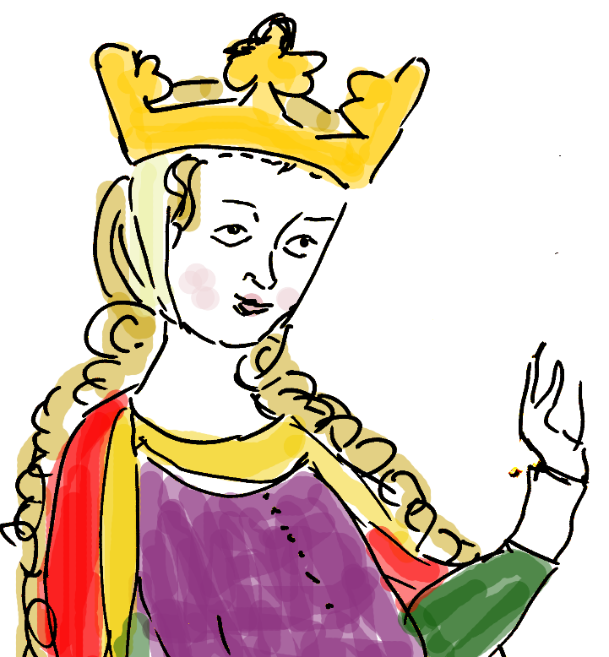
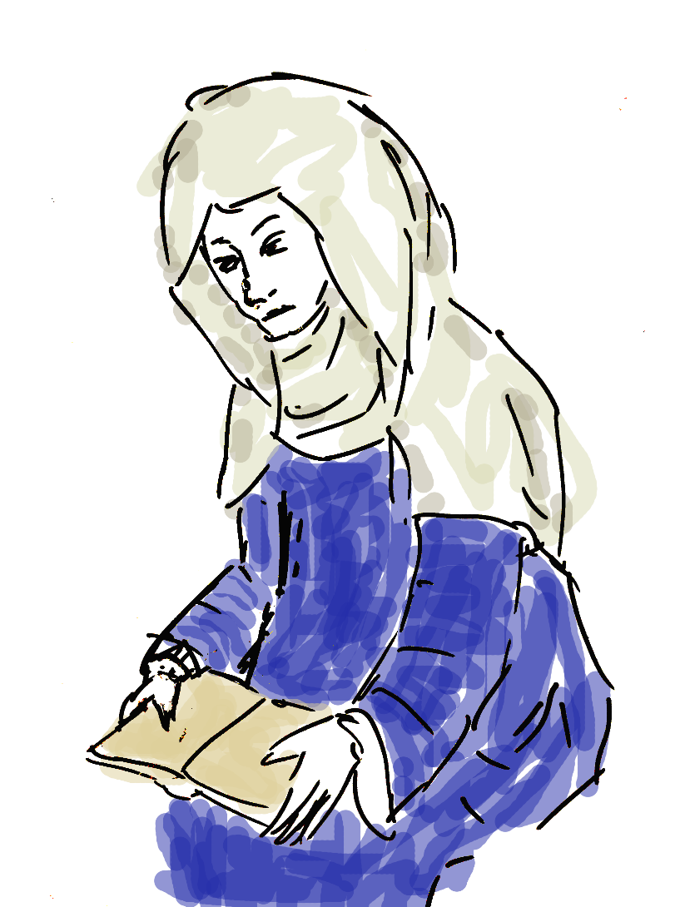
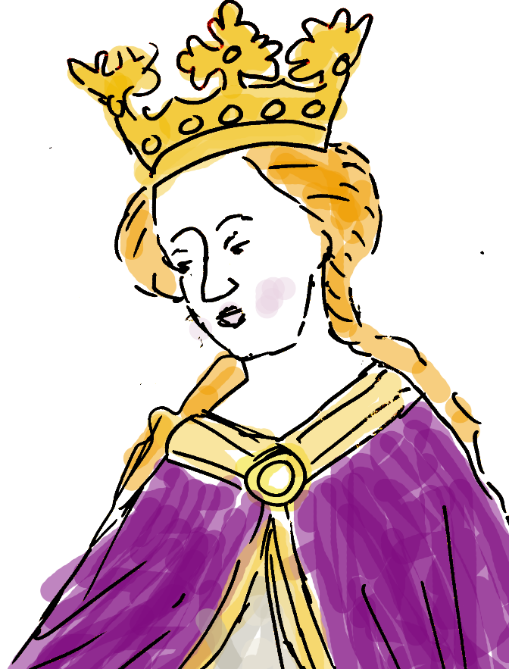
Eleanor of Aquitaine
Julian of Norwich
She owned lots of land in France.
She was married to the King of France .
Then she was married to the King of England.
Two of her sons became King of England.
She went on Crusade, (fighting in the Holy Land where Jesus had lived)
She was a nun.
She lived in Norwich.
She wanted to concentrate on God and praying.
She was a special nun. She lived in a room on the side of the church.
When she went into the room the door was bricked up. There was no way out.
Margery Kempe
Margaret of Anjou
She wrote a book about her life.
She lived in a town called Lynn.
For most of her life she was normal.
Her life changed when she had visions. She saw devils, God, Jesus and his mother Mary.
She was Queen of England.
She was married to a weak king.
She wanted to rule England as her husband couldn’t.
She fought to make sure her son would be King of England.
She led an army during the Wars of the Roses.

Slide 33
Endless quizzes?
ndless quizzes
ndless quizzes
ndless quizzes

Slide 34
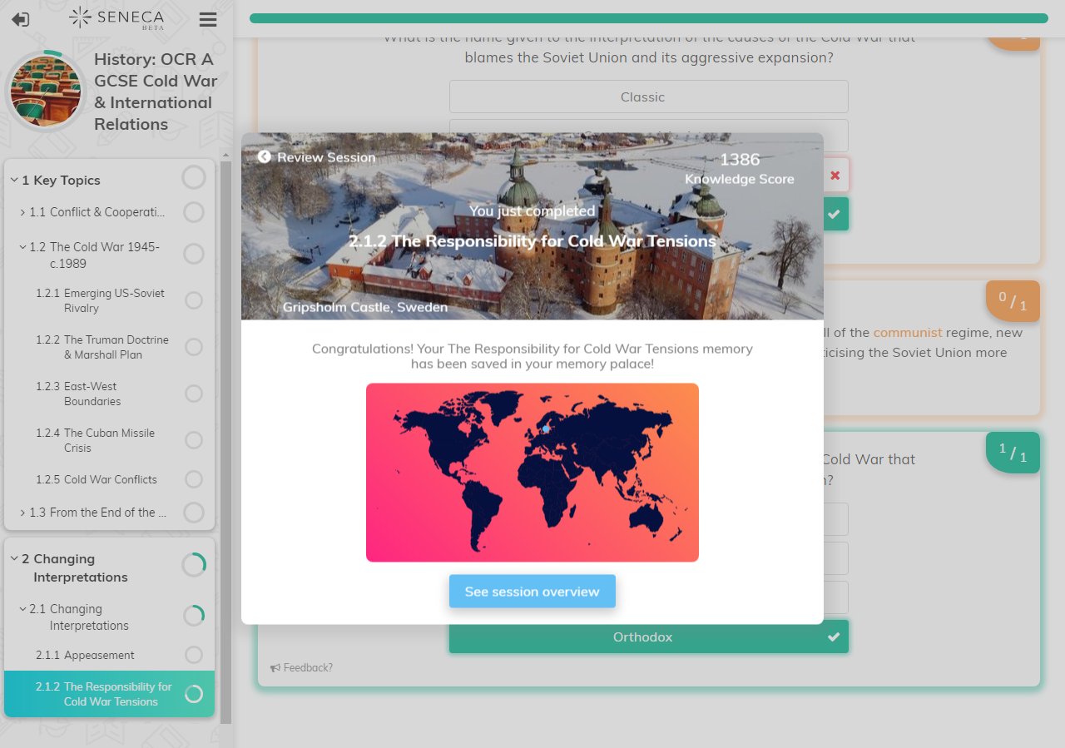

Slide 35





Moodle
Microsoft Forms
Google Forms
Floobaroo
GCSEPod

Slide 36
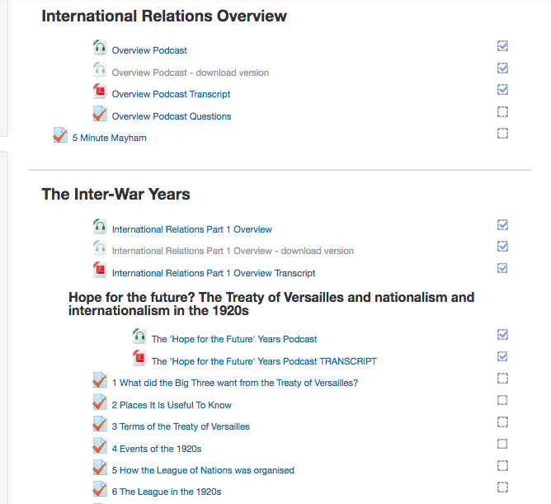

Slide 37


Slide 38
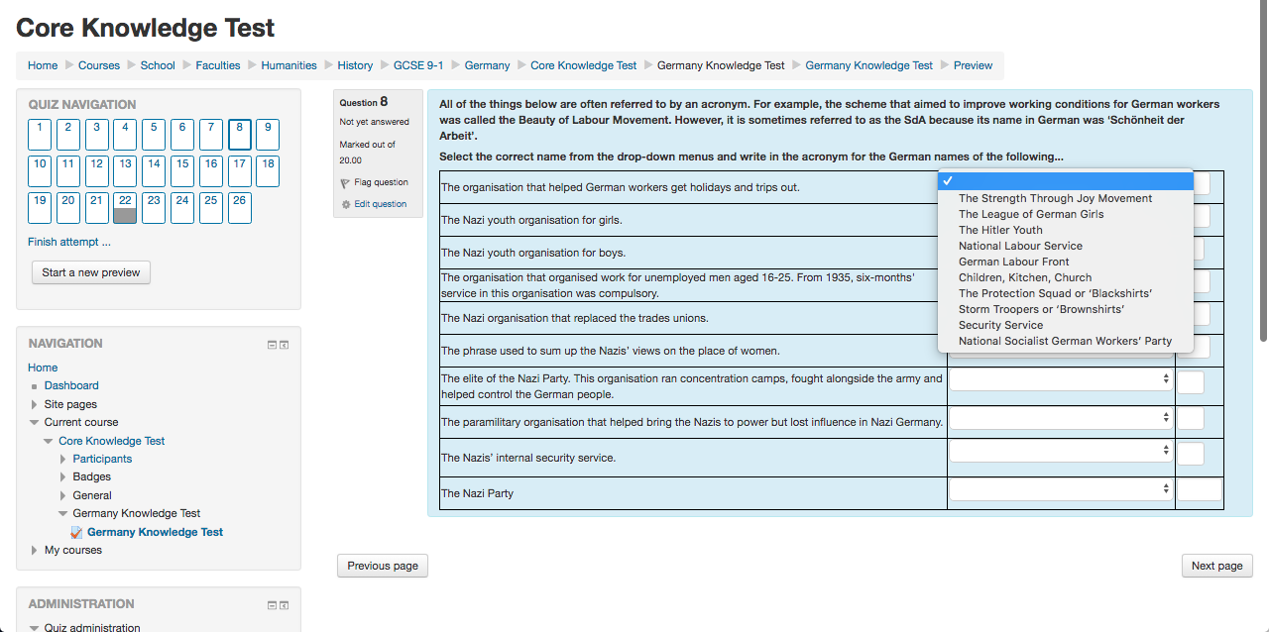

Slide 39
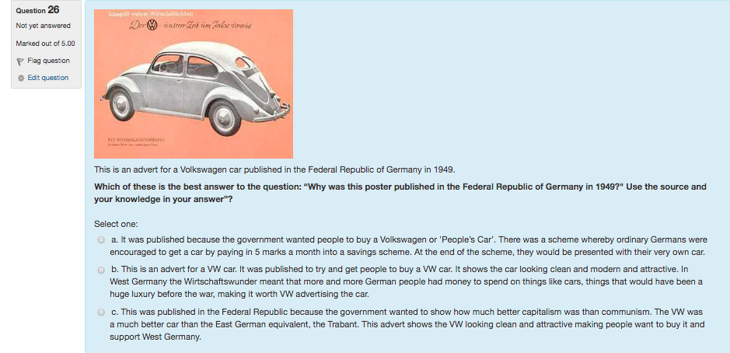

Slide 40
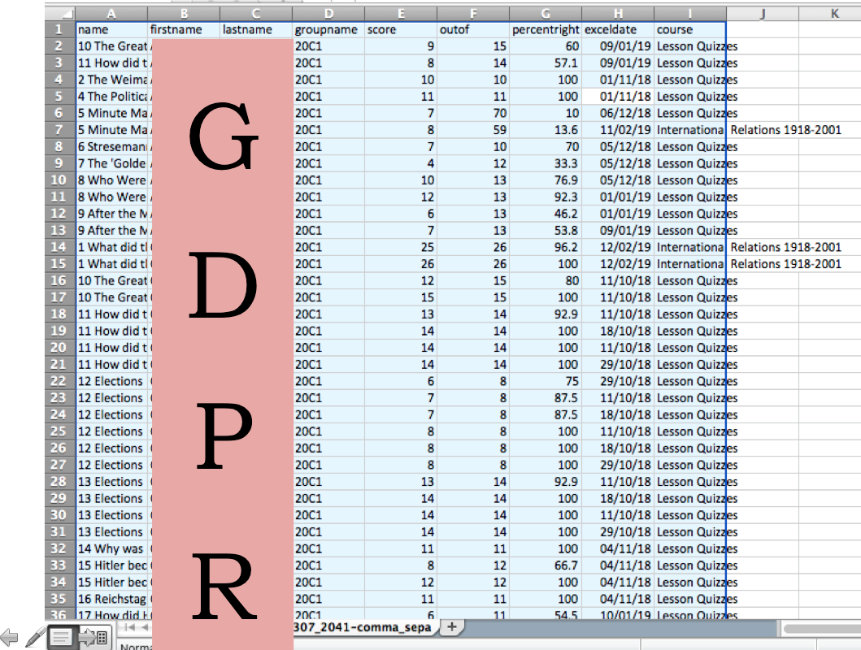

Slide 41
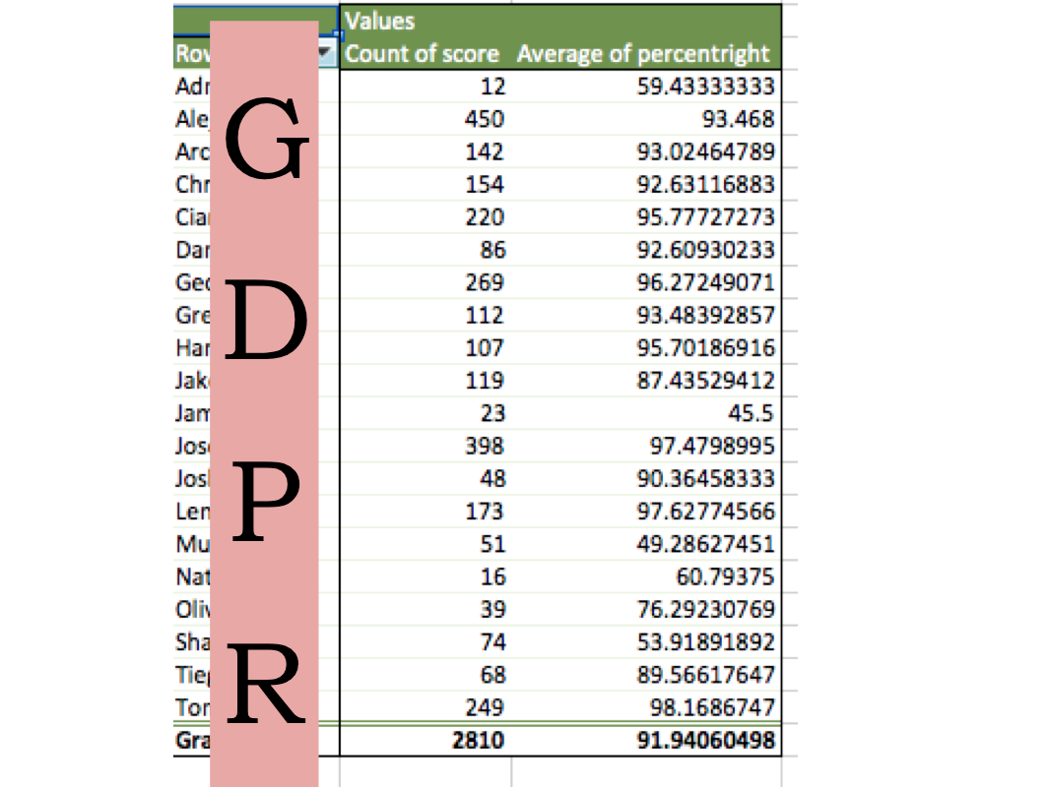

Slide 42
=F(UNCTIO,N$)

Slide 43
rouping
rouping
rouping
rouping
G
rouping
rouping
rouping
rouping

Slide 44




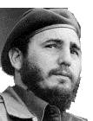





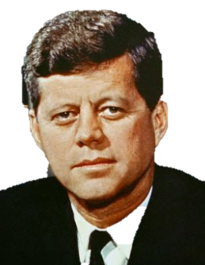









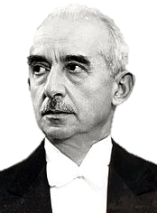
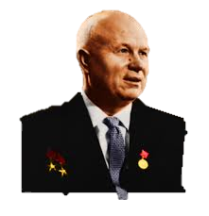



DEMOCRATIC PARTY

Slide 45
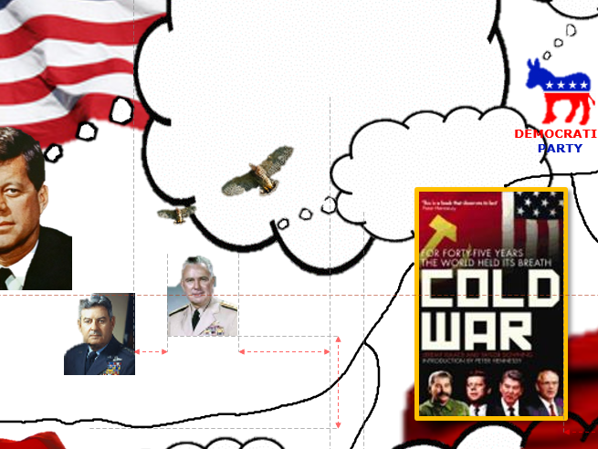

Slide 46
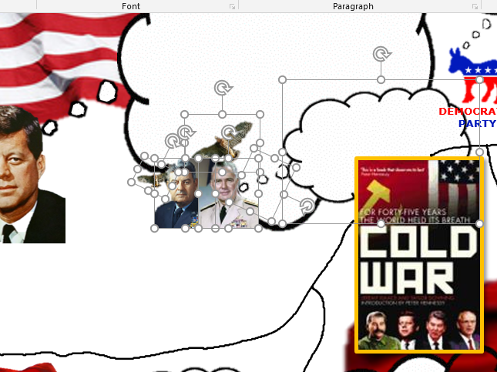

Slide 47
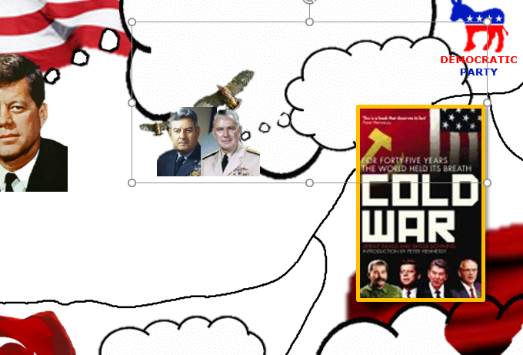

Slide 48
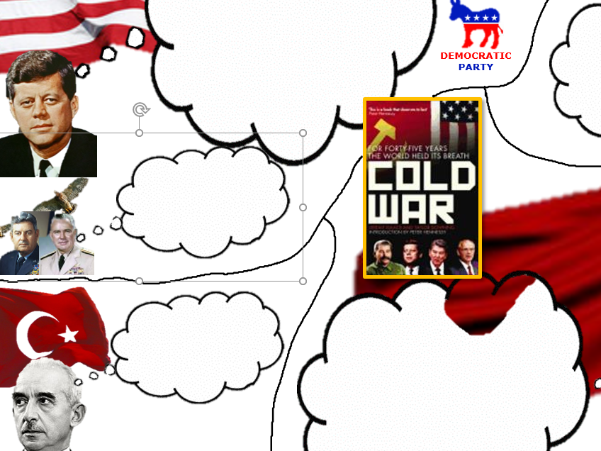

Slide 49
DEMOCRATIC PARTY

Slide 50
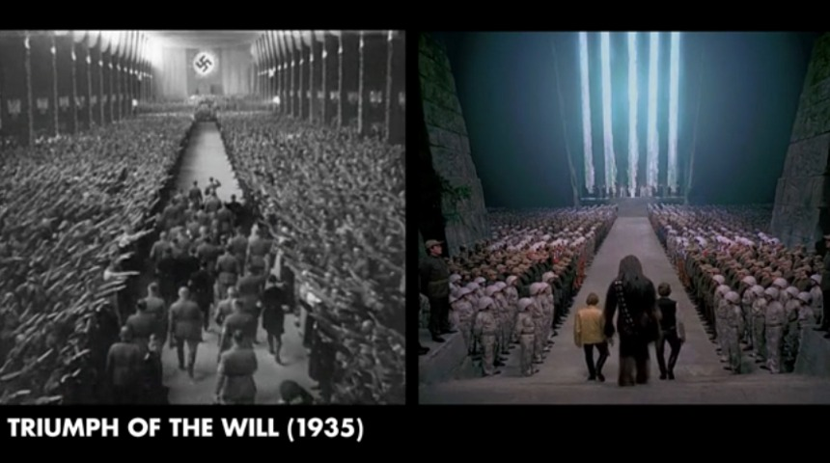

Slide 51
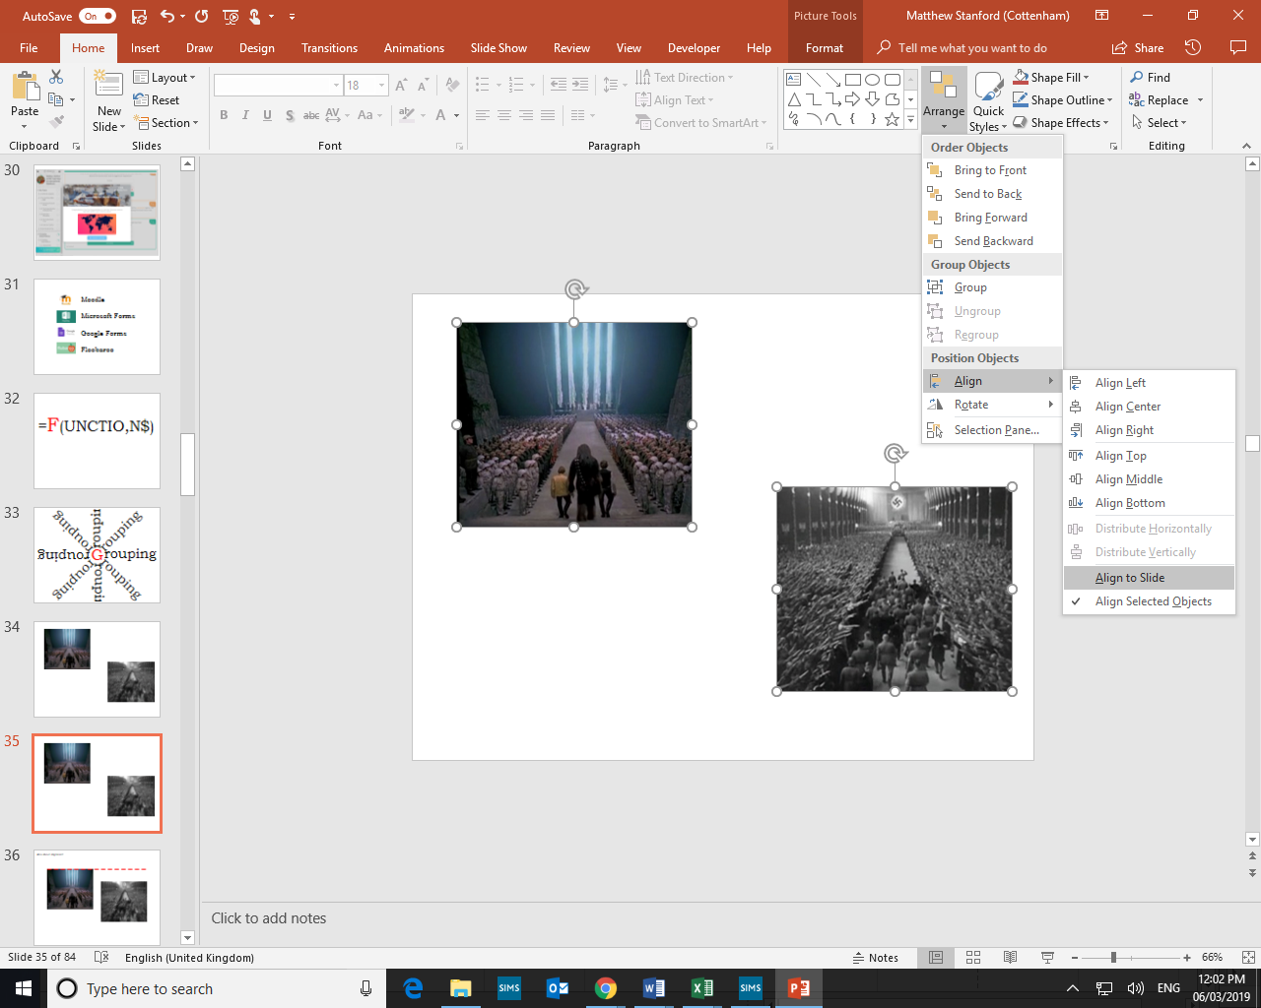

Slide 52
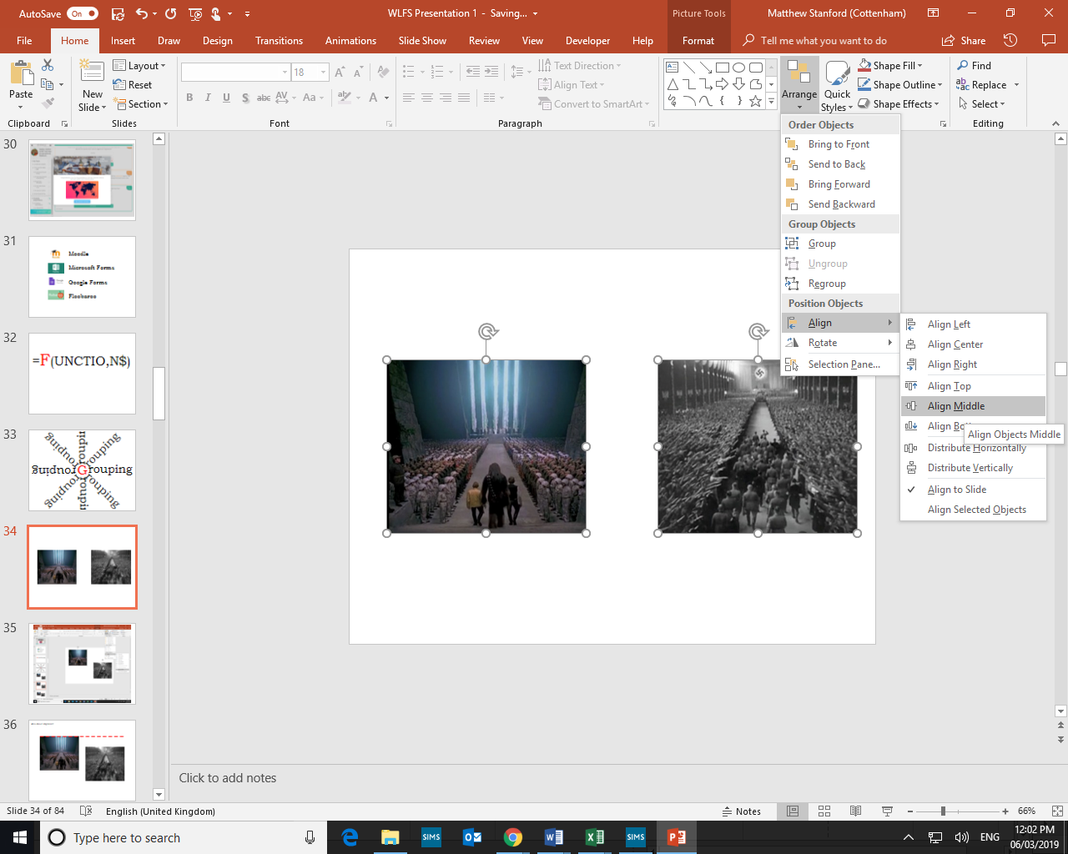

Slide 53
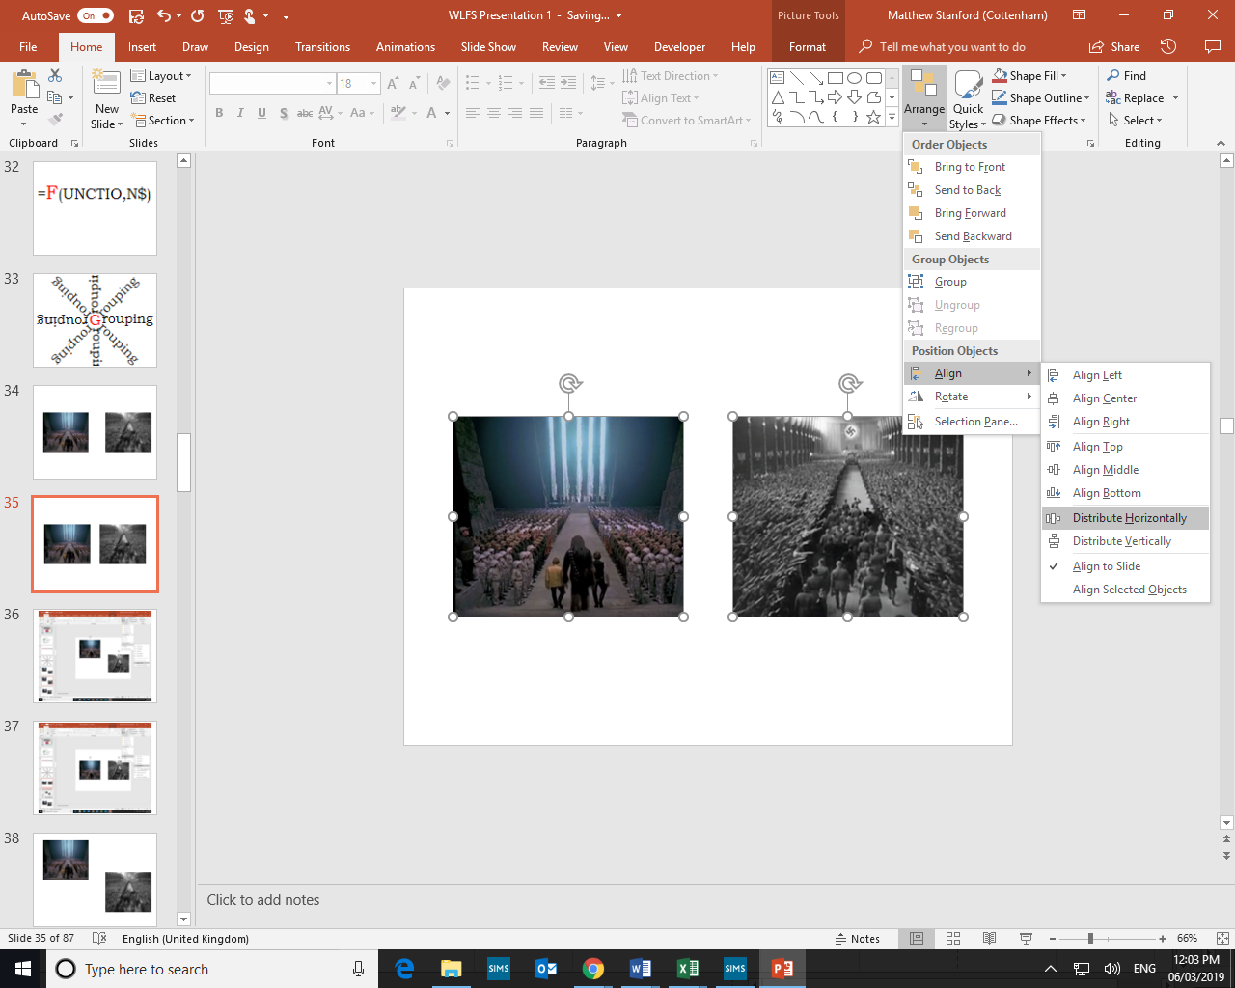

Slide 55


Slide 56
Hide

Slide 57
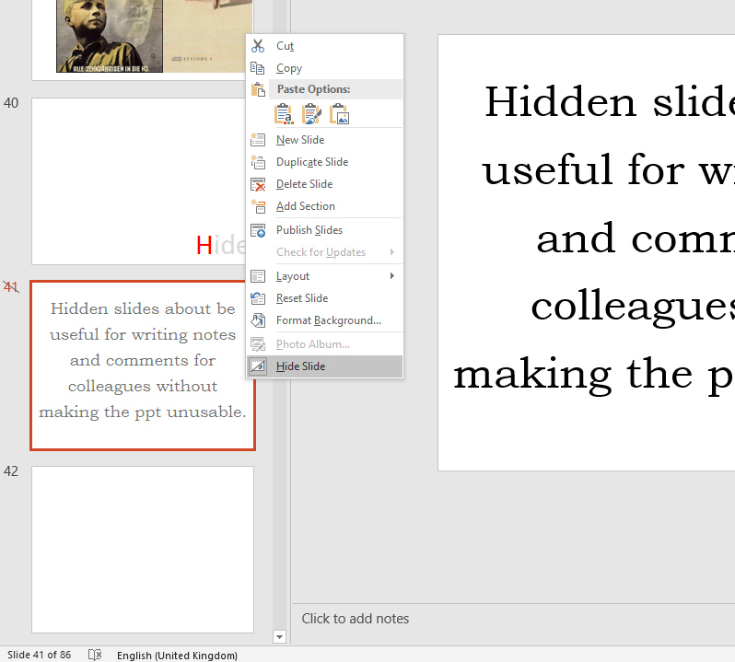

Slide 58
Hidden slides about be useful for writing notes and comments for colleagues without making the ppt unusable.

Slide 59
If the computer will let me…

Slide 60
Jab
screens

Slide 61
“Shiny twit machines”

Slide 62
Keyboard shortcuts
cut
ctrl + x

Slide 63
s
t
u
f
f
u
p
Looking stuff up

Slide 64


Slide 65


Slide 67


Slide 68
<<Mail merge>>

Slide 69


Slide 70


Slide 71


Slide 72


Slide 73


Slide 74


Slide 75


Slide 76


Slide 77


Slide 78


Slide 79


Slide 80


Slide 81


Slide 82


Slide 83


Slide 84


Slide 86

Year 8 on the causes of the English Civil War

Slide 87

Year 8 on the causes of the English Civil War

Slide 88

Year 8 on the causes of the English Civil War

Slide 89

Year 11 on people’s reactions to the Reformation

Slide 90

Year 11 on people’s reactions to the Reformation

Slide 91
Year 8 on the causes of the English Civil War
Your PowerPoint resources then become the feedback.

Slide 92

Application
Application print preferences
Printer driver preferences

Slide 93


Application
Application print preferences
Printer driver preferences

Slide 94
Office
online

Slide 95

Department’s Year 9 Mark-book

Slide 96

Department’s Year 9 Mark-book

Slide 97
P i v o t
T
a
b
l
e

Slide 98



Slide 99
Quick analysis

Slide 100

Quick analysis

Slide 101
Recorded
feedback
o

Slide 102

55 of 66 students chose to respond
31 positive comments
19 that were neutral or contained positive and negative comments
2 that only contained negative comments.
13 pupils suggested that feedback in history was the best feedback they received in school.
it is the best as I can understand it better than a sheet of paper as it describes it more than a bit of text
very helpful and far better than written feedback that is given in other lessons... easier to respond back to and to understand.
you can play it multiple times
I prefer to get feedback with the mp3s instead of questions in our books because its easier to understand and you can explain what you mean and if I forget what you said I can just play it back.

Slide 103
A Year 9 student voice survey about recorded feedback:
55 of 66 students chose to respond
31 positive comments
19 that were neutral or contained positive and negative comments
2 that only contained negative comments.
13 pupils suggested that feedback in history was the best feedback they received in school.

Slide 104
A Year 9 student voice survey about recorded feedback:
18 praised the detail of the feedback.
16 praised the clarity
6 said that it encouraged reflection
12 said that clear tasks were set.

Slide 105
A Year 9 student voice survey about recorded feedback:
“I prefer to get feedback with the mp3s [sic] instead of questions in our books because its easier to understand and you can explain what you mean and if I forget what you said I can just play it back.”

Slide 106

Paste Special
Special

Slide 107

alt + e then s
ctrl + alt + v

Slide 108


Slide 109


Slide 110
This is a cool worksheet!
Here is a question.
Here is another question.
Here is an extension task,

Slide 111


Look at this picture and use it to help you with your cool worksheet.

Slide 112
Typography
matters

Slide 113


Slide 114


Slide 115


Slide 116


Slide 117
Professor John Stein, emeritus professor of physiology at the University of Oxford said:
“It’s a complicated subject… The short answer is that the only things that really help dyslexics are larger letters and wider letter and word spacing as we showed nearly 40 years ago and that has been confirmed time and time again. Sans serif, monospaced and Roman sans serif are probably best for dyslexics. Italic is the worst . But italic ‘dysfluent’ fonts slow down everyone, yet everyone, including dyslexics, tends to remember the content better because they’ve had to concentrate more.”
https://www.tes.com/news/does-comic-sans-help-dyslexic-learners
Jan 2018

Slide 118
Ümläut

Slide 119
alt + i then s
or
alt + code

Slide 120



V
B
A

Slide 121


Slide 122
W
hite space…

Slide 123
…is beautiful

Slide 124


Slide 125



Slide 126


Slide 127
X
e tracting information

Slide 128


Slide 129


Slide 130
Y
wh
?

Slide 131
A Manifesto
We should use the tools that are already at our disposal to teach history to the best of our ability.
We should use the tools that are already at our disposal to reduce our workload as far as possible.
As teachers we are role models – we should model good design and good presentation. If we don't, who will?
Good design makes us better educators by increasing the accessibility and comprehensibility of our resources.
Good design is pleasant to look at. Our students deserve nice things.
Most importantly, we should model the mastery of technology rather than present ourselves as its victims.

Slide 132
Z + ctrl

Slide 133


>

Slide 134
Are your students using a typewriter or a word processor?
When do you ask students to write the introduction to an essay?
Do you use comments for marking? Do students have to ‘resolve’ the comments when responding to feedback?
How can you use highlighting when marking?
When do you ask students to ‘link’ paragraphs?
Where do you ask students to write their essay plans?
What speech-to-text facilities are available to you? To whom might they be useful?

